Slide 1
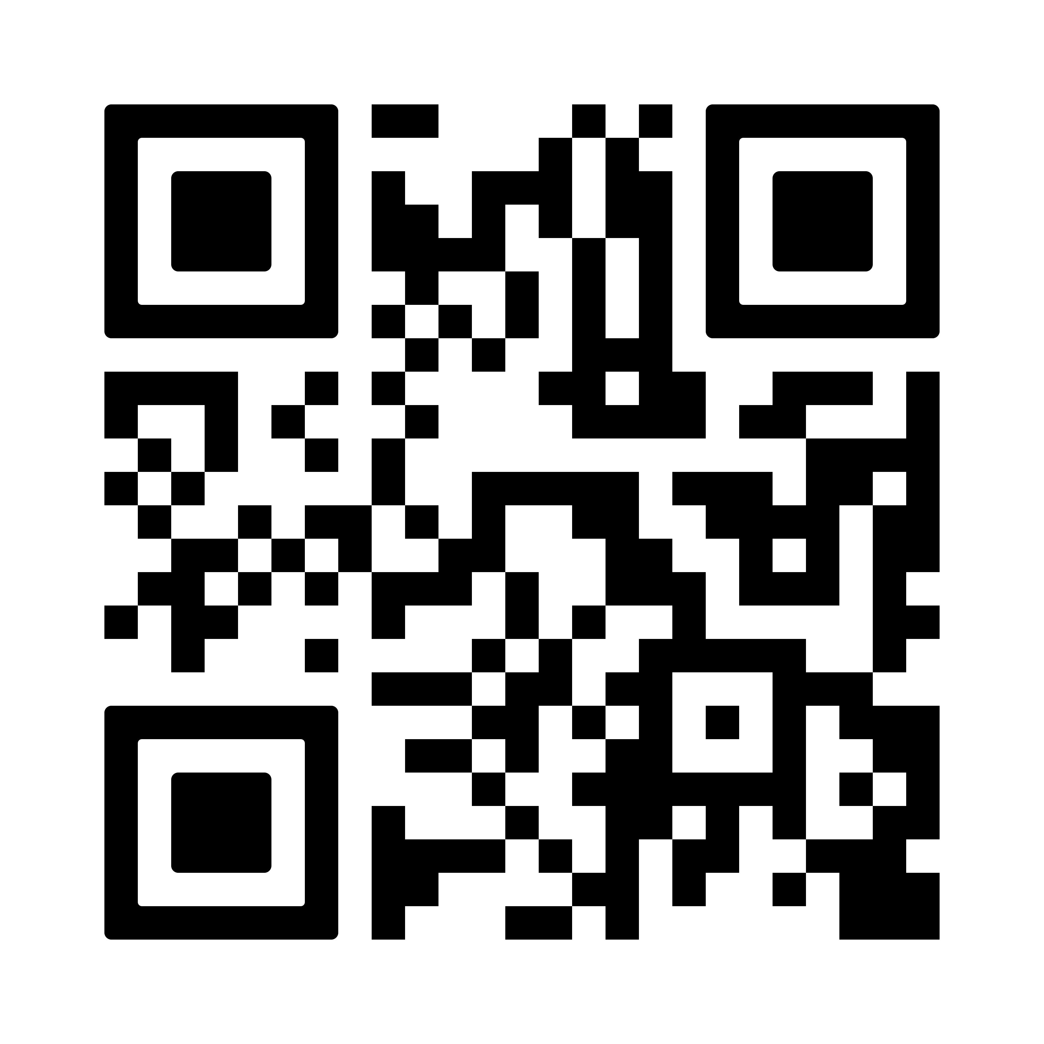
Need your next supply of oral contraception?
You can now arrange to get your next supply directly from
a local pharmacy in conﬁdence.
Pharmacies close to …………….offering the service:
Pharmacy 1 Wootton Pharmacy, 40 High Street, Wootton NN4 6JR
Pharmacy 2 Tudor Pharmacy, Tudor Court, Wootton Hope Dr, Northampton NN4 6FF
For a full list of pharmacies please scan the QR
code. Please call the pharmacy before walking in.

