Slide 1
Patient Survey Results October 2025- January 2026

Slide 2
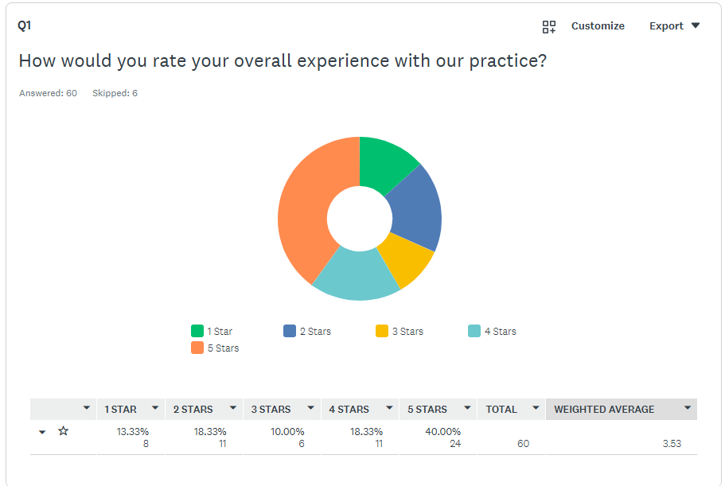

Slide 3
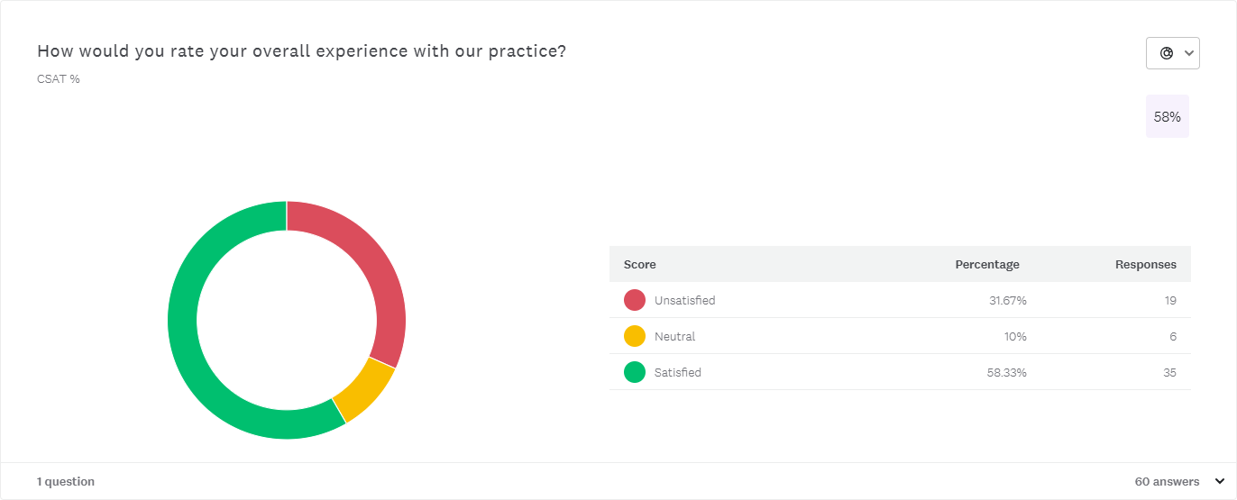

Slide 4
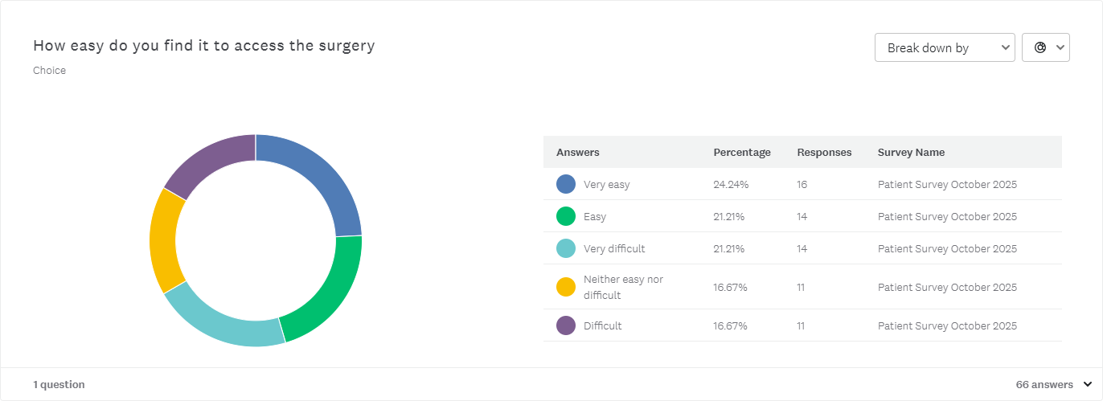

Slide 5
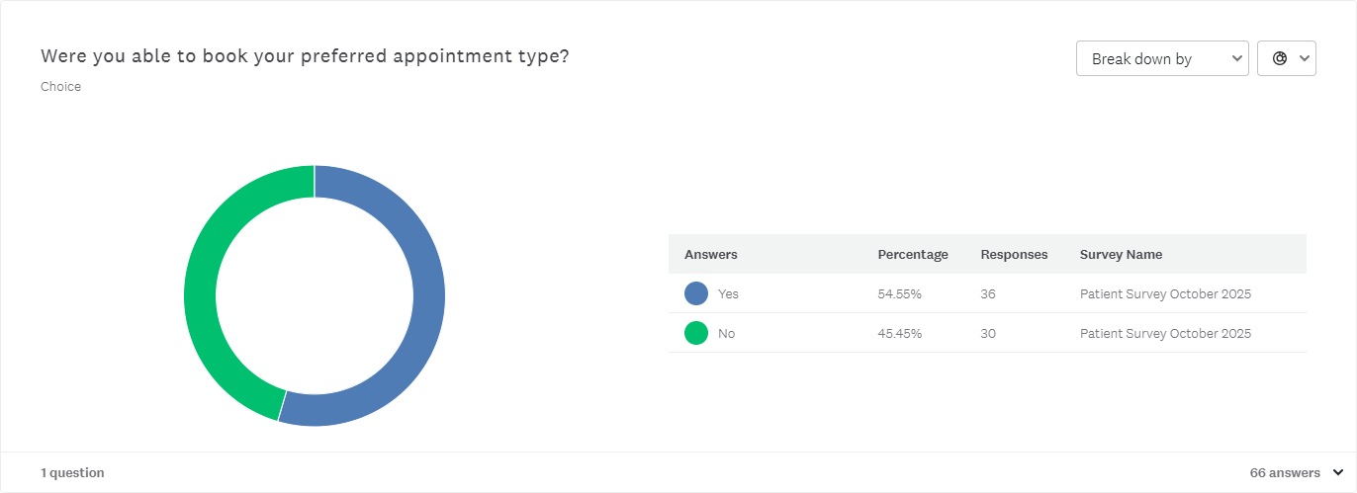

Slide 6
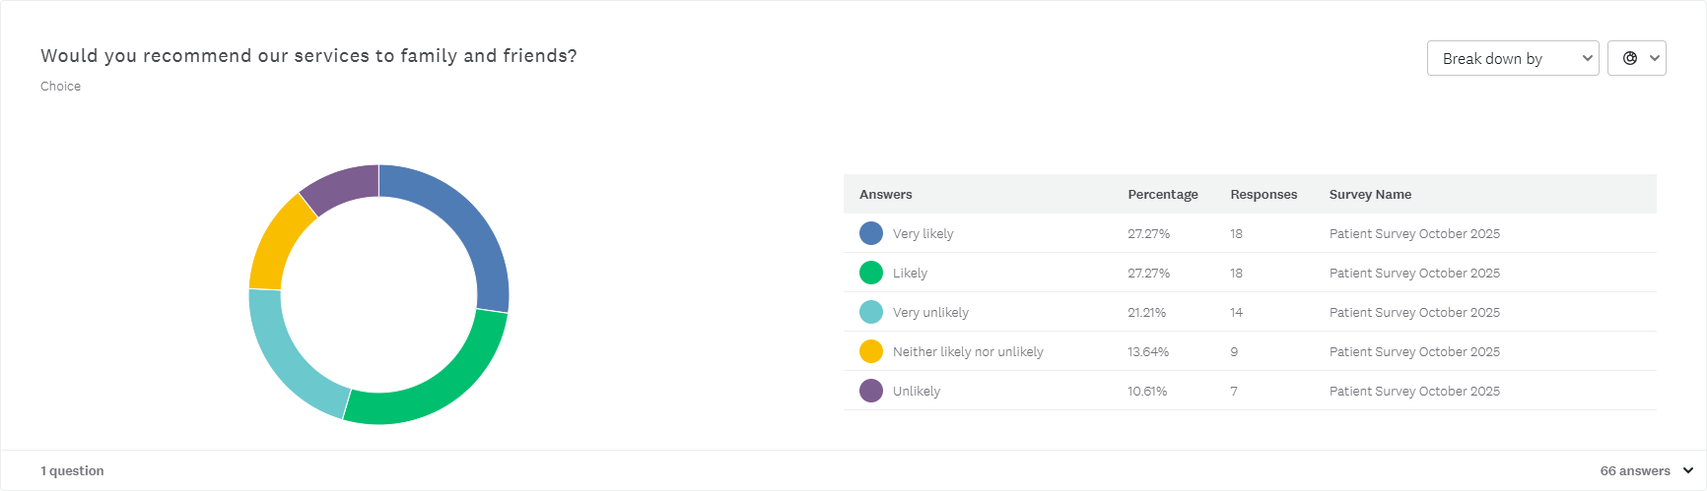

Slide 7
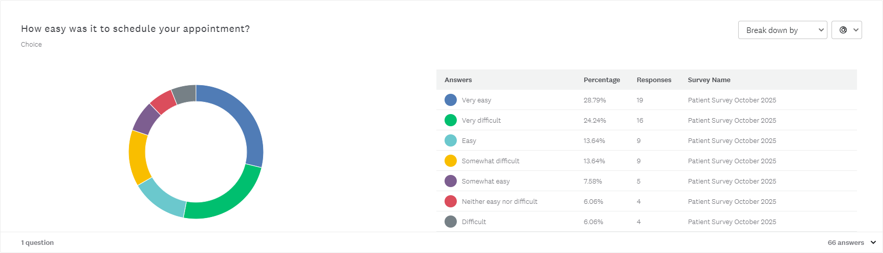

Slide 8
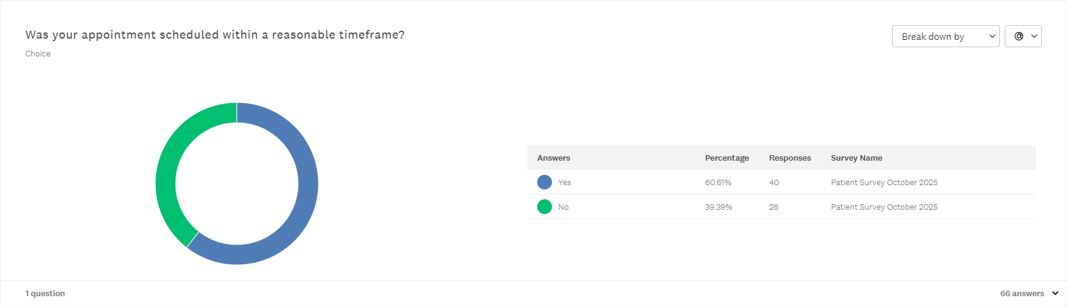

Slide 9
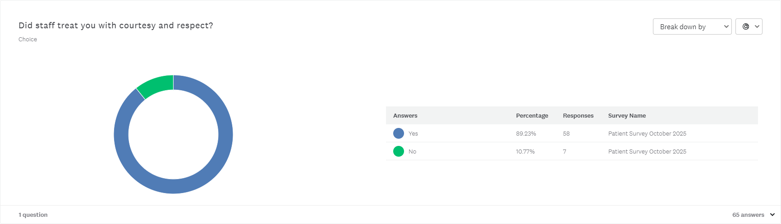

Slide 10
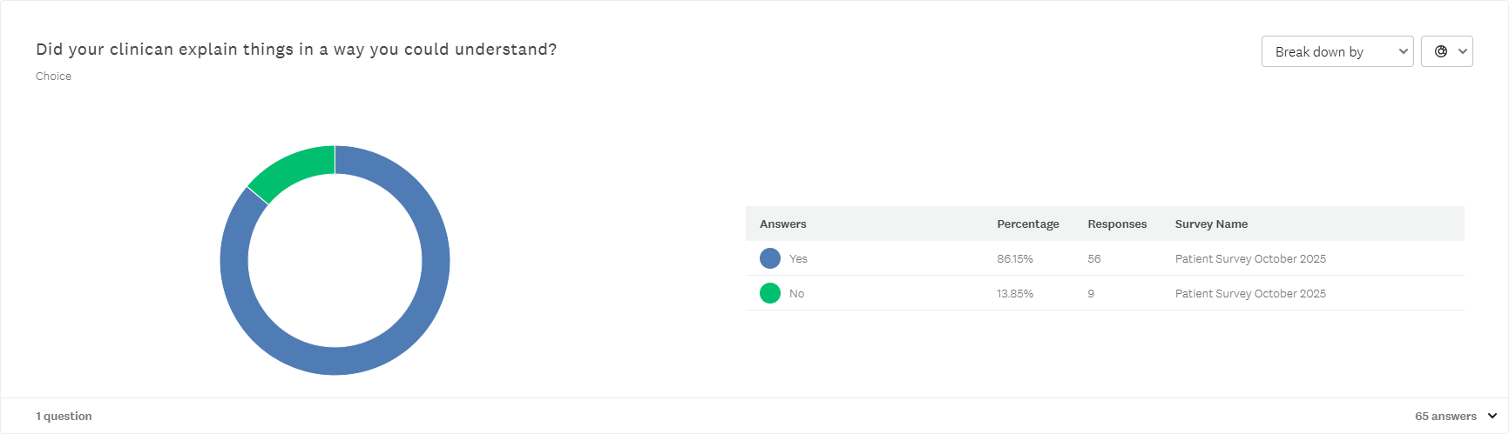

Slide 11
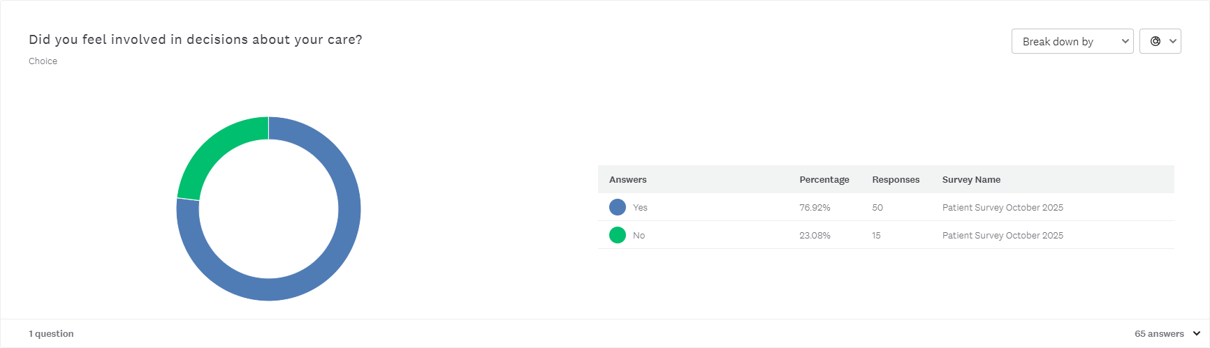

Slide 12
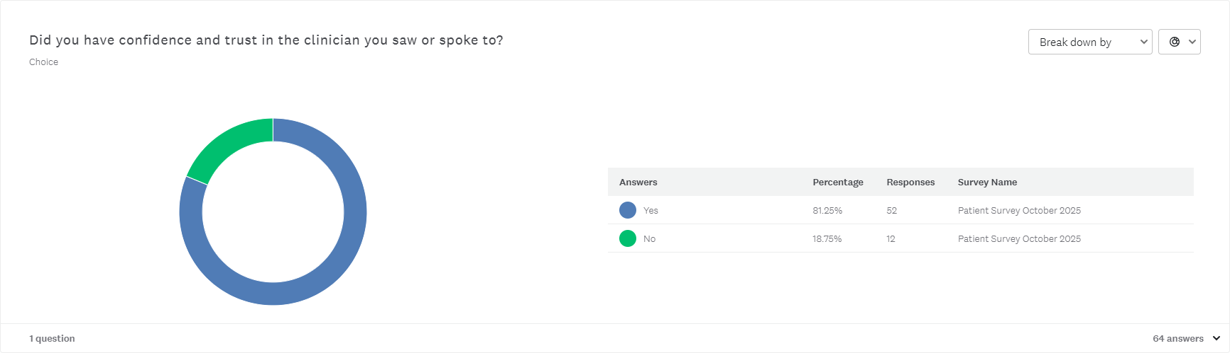

Slide 13
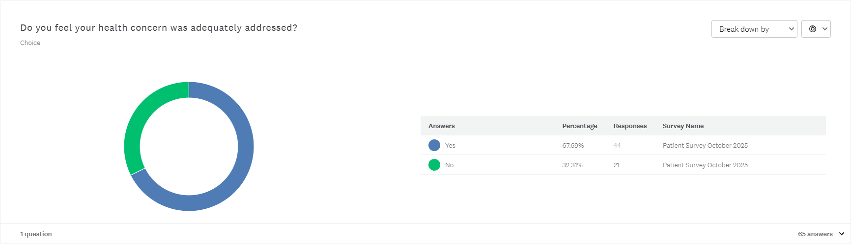

Slide 14


Slide 15
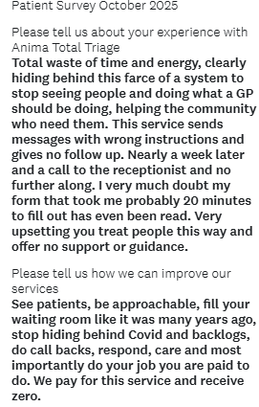
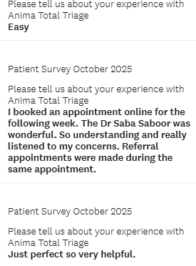
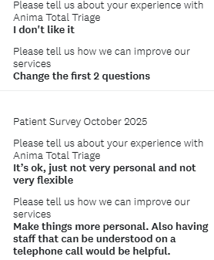
Patient Comments

Slide 16
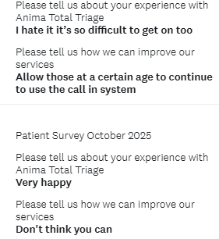
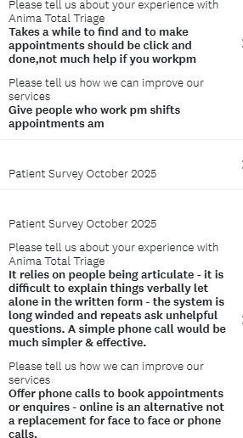
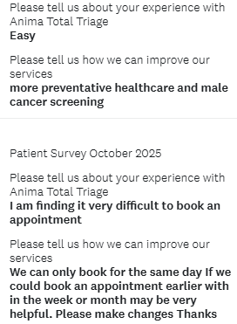
Patient Comments Continued…

Slide 17
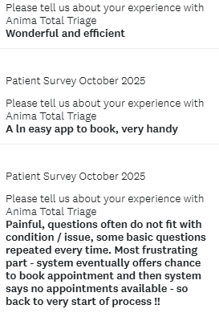
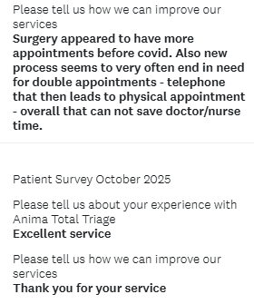
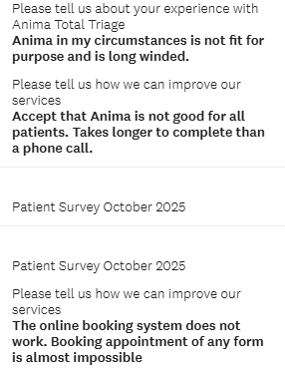
Patient Comments Continued…

Slide 18
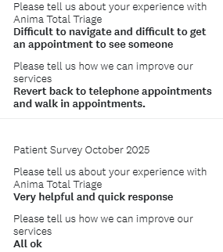
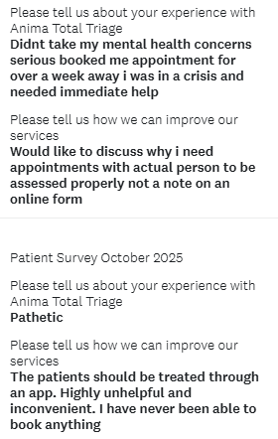
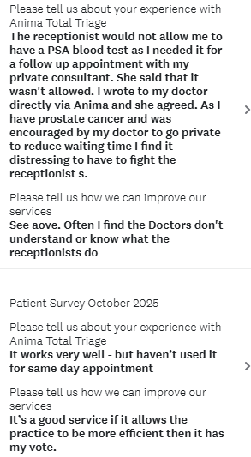
Patient Comments Continued…

Slide 19
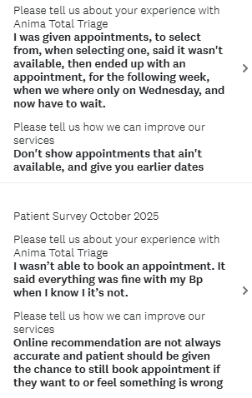
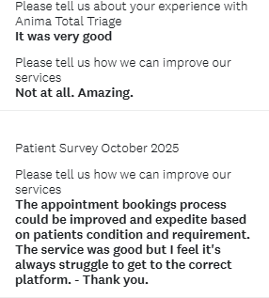
Patient Comments Continued…

Slide 20

Summary of Practice responses:

Slide 27
Thank you
We would like to extend our sincere thanks to all patients who took the time to complete our recent patient survey. Your feedback is invaluable in helping us understand what we're doing well and, more importantly, where we can improve our services. We recognise that your time is precious, and we genuinely appreciate you sharing your experiences and views with us. The insights you've provided will directly inform our quality improvement initiatives and help shape the future development of our practice. We are committed to carefully reviewing all responses and will be sharing key findings and any resulting action plans with our patient community in due course. Thank you for helping us to continue providing the best possible care for our patients.

